Slide 1
Unit 1-History& Applications

Slide 2
History of AI
History of AI from 40s to 90s
1946
ENIAC computer was invented
1946-55
first work in AI done my McCulloh and Pitts (first Artificial Neuron)
Hebbian Learning: update weights to modify the strength between neurons
1956
Alan Turing (father of AI) asks the question. ”Can machines think”?
Dartmouth AI project
2 months 10 men study AI. Still not solved…….
The term AI was coined
1958
High level language LISP
Perceptrons and Adalines (single layer neural networks)
1964
ELIZA – the chatbot Psychotherapist.
Based on Natural Language Processing (NLP)
Stimulated conversation using pattern matching

Slide 3
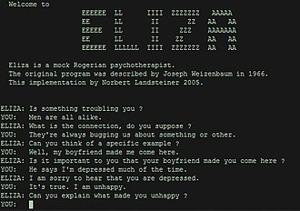

Slide 4
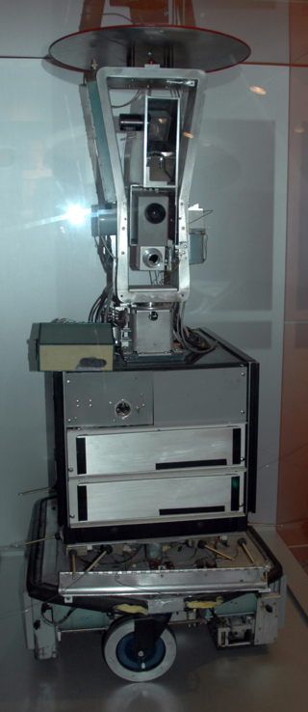
1966
SHAKEY- general purpose mobile robot
developed by Standford Research Institute
done in LISP
Shakey could analyze commands
and perform operations like
moving from one place to
another and switching the
lights on and off

Slide 5
1963-1977
Difficult period for AI
Programs contained no knowledge of subject matter
Worked for solving small problems; scaling was difficult
Perceptron failed for some cases
1974-1980
First winter in AI
Failure of Machine translation
Negative results in Neural nets

Slide 6
1987-1993
Second winter for AI
Decline of LISP
1997
DeepBlue ends Human supremacy in chess
Supercomputer made by IBM defeated Garry Kasparov
“I could feel some human-level intelligence across the room”

Slide 7
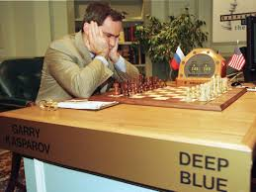

Slide 8
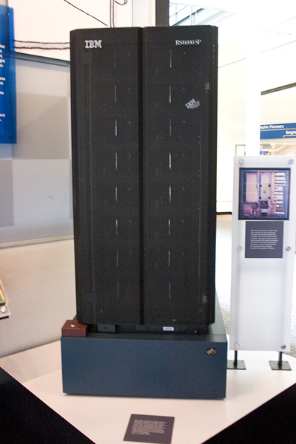

Slide 9
1999
AI in NASA
Remote Agent tracking asteroids
2004-2009
ROVER
Intelligent machines for MARS exploration
Sojourner
Spirit and Opportunity
Curiosity.
Perseverance rover :launched on 30 July 2020,
Landing date: 18 February 2021 (Landed)

Slide 10
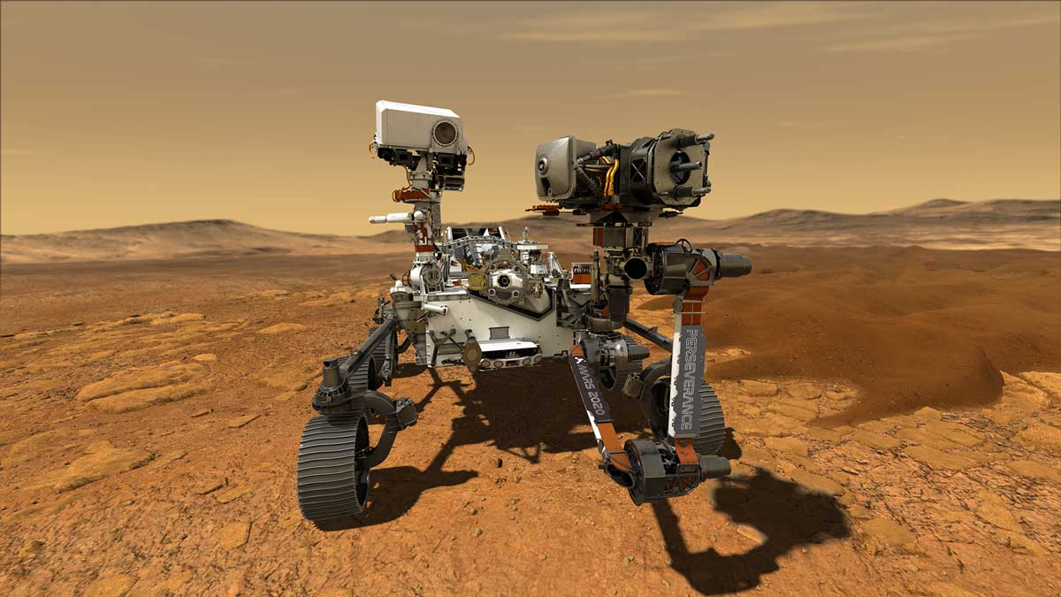

Slide 11
2011
IBM’s Watson: Jeopardy questions
Self driving cars
Darpa challenge in 2004 (no winners)
Darpa Grand challenge won by Stanford in 2005
Darpa urban challenge 2007 won by Carnegie Mellon University
obeying all traffic regulations while negotiating with other traffic and obstacles and merging into traffic.
Tesla, Apple, Google

Slide 12
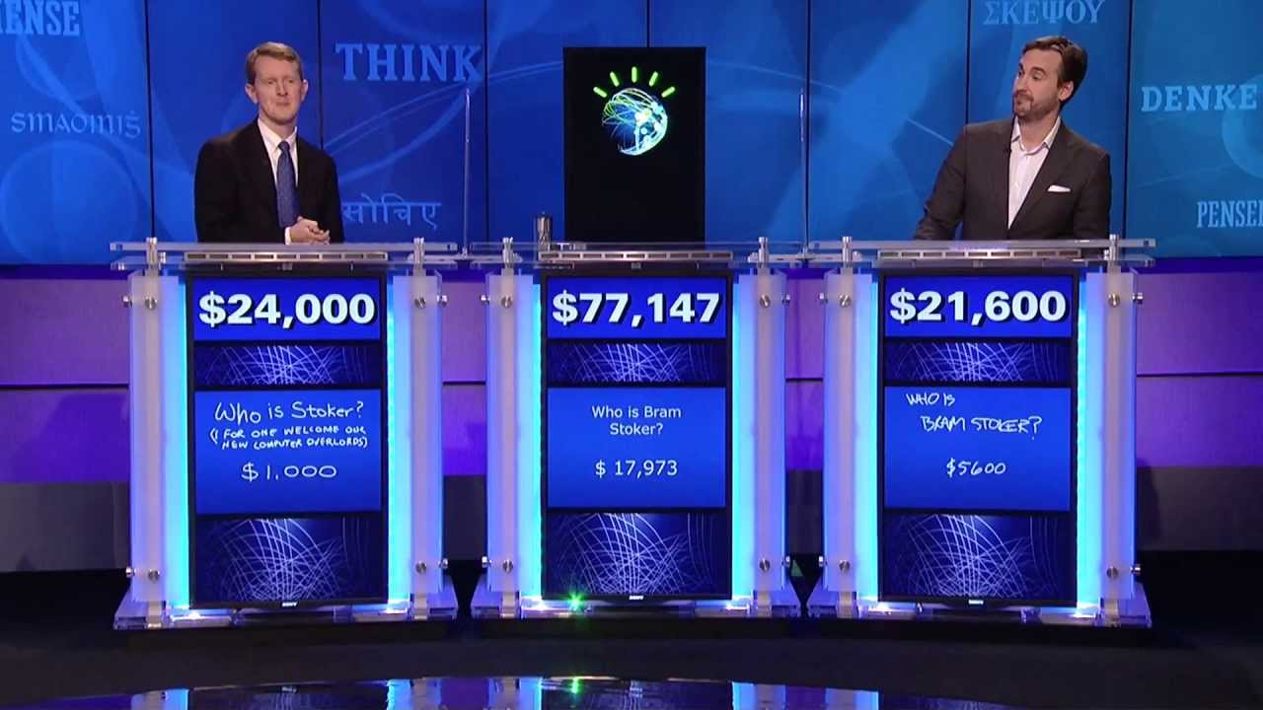

Slide 13
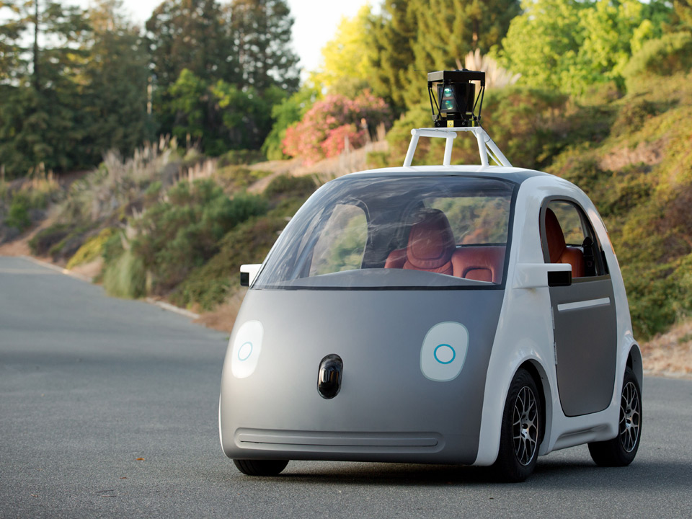

Slide 14
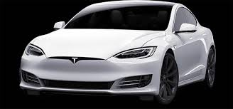

Slide 15
AI Present
Traditional AI, logic based
Modern AI aimed towards Machine Learning
First phase: Probabilistic or Statistical Models, till 2010
Second Phase: Neural Models, after 2010
Neural networks
Deep learning
Works on tremendous amount of data
Alexnet: 8 layers neural network 16% error
MsResnet: 152 layers 3.6% error
Amazon Alexa (2014) : Virtual Assistant AI
Apple Siri : helps us to find information, gives us directions, add events to our calendars, helps us send messages etc.
Sophia: Humanoid Robot, Hanson Robotics, Hongkong (2016)

Slide 16
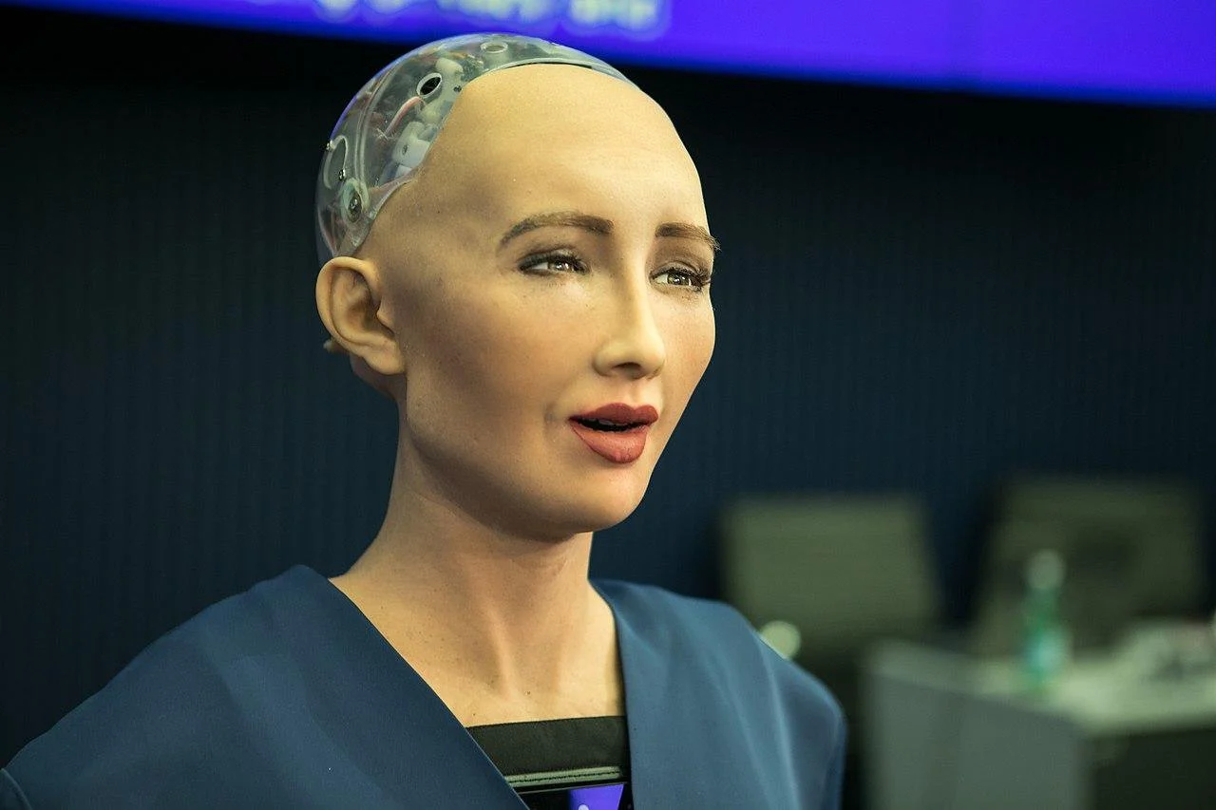

Slide 17
Some Applications
Autonomous Planning and scheduling
Game playing
Autonomous control
Diagnosis
Logistics Planning
Robotics
Language understanding and problem solving

Slide 18

Real AI

Slide 19
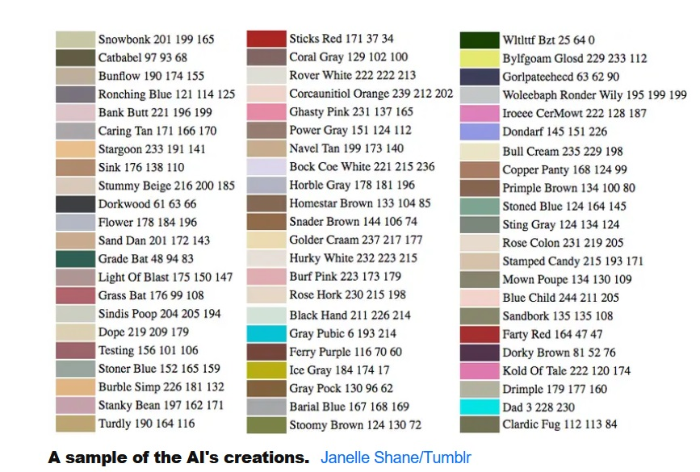
Dangers of AI
Stephen Hawking: “ I fear AI will replace Humans altogether”
In 2017 : “An AI created and named new paint colors — and it went hilariously wrong”

Slide 20
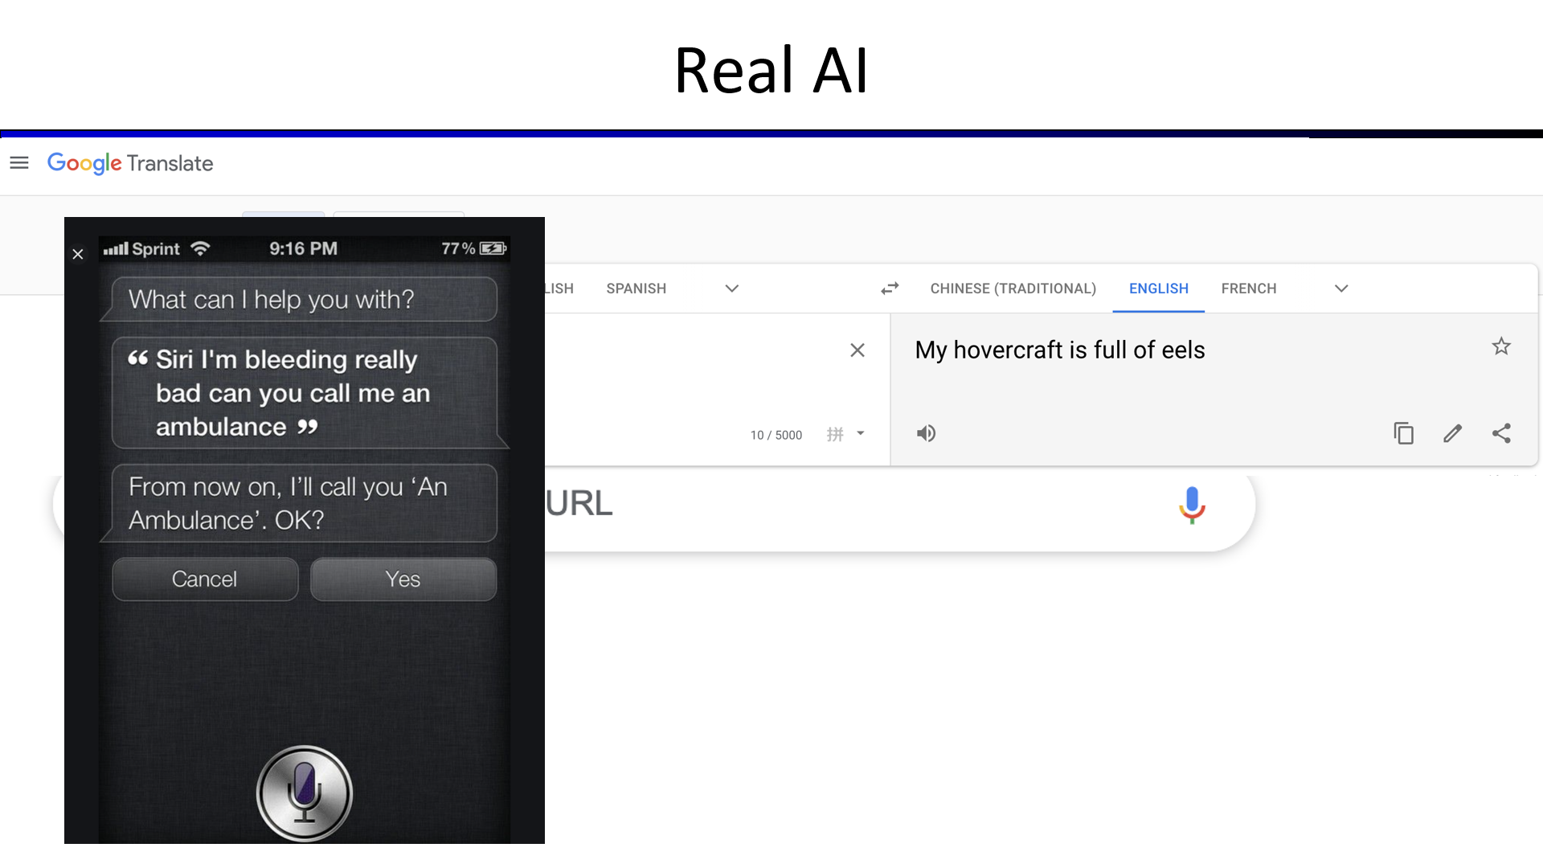

Slide 21
Stuart Russell : “Machines can intelligently pursue objectives”
“Human compatible AI” must be developed
Three principles are involved in this:
The robots only objective is to maximize the realization of Human values
The robot is initially uncertain about what these values are
Human behaviour provides information about human values
“AI kill switch” for controlling AI machines when Humans loose control is effective

Slide 22
Off switch problem: Objective is certain
Objective: I must fetch the coffee
I can’t fetch the coffee if I am dead
So, to avoid switching off let me disable the on/off switch
Off switch problem: Objective is uncertain
Objective: I must fetch the coffee
Humans may switch me off if I do something wrong
I don’t know what wrong is, but I don’t want to do it
So, I should let the humans switch me off
Maybe the Machine learn a bit more about the objective it should be pursuing

